Slide 1

Retinal Vessel Segmentation
A Comparative Study of UNet, UNet++ and TransUNet
Hao ShiLong, Dong YiZhi, Wang ZiFan, Dong WenYu, Zhang TongYu
Retinal Vessel Segmentation | Deep Learning | Diabetic Retinopathy | TransUNet
December 2025
Notes:
大家好，今天我将为大家汇报我们关于视网膜血管分割的最新研究成果。我们的研究题目是“Retinal Vessel Segmentation: A Comparative Study of UNet, UNet++ and TransUNet”。

Slide 2
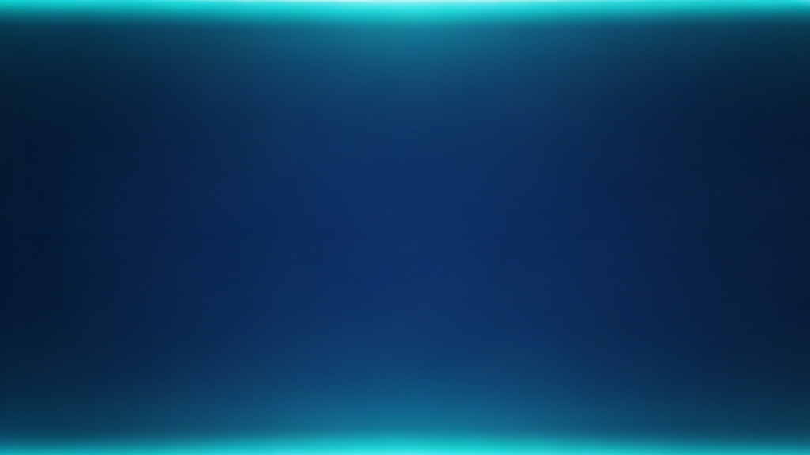





Abstract
Research Background
Retinal vessel segmentation is critical for early screening of diabetic retinopathy (DR). Existing methods struggle with fine branch extraction and topological structure restoration.
Methodology
Systematic comparison of three deep learning models (UNet, UNet++, TransUNet) using DRIVE/STARE public datasets.
Evaluation Dimensions
Qualitative (continuity, fine branches, topology) and Quantitative (Acc, Sen, Spe, AUC).
Key Results
TransUNet achieves90%+fine branch retention and optimal performance (DRIVE: Acc=0.7952, AUC=0.9821).
Significance
Notes:
首先，让我们来看一下本次研究的摘要。视网膜血管分割是糖尿病视网膜病变等眼部疾病早期筛查的关键。然而，现有方法在细小血管提取和拓扑结构恢复方面仍存在挑战。为此，我们系统地比较了三种主流的深度学习模型：UNet、UNet++和TransUNet。我们从定性和定量两个维度进行了评估。结果表明，TransUNet在各项指标上均表现最优，尤其是在细小血管保留率方面超过了90%。这项研究的意义在于，我们建立了一个更贴合临床需求的多维度评估体系。

Slide 3
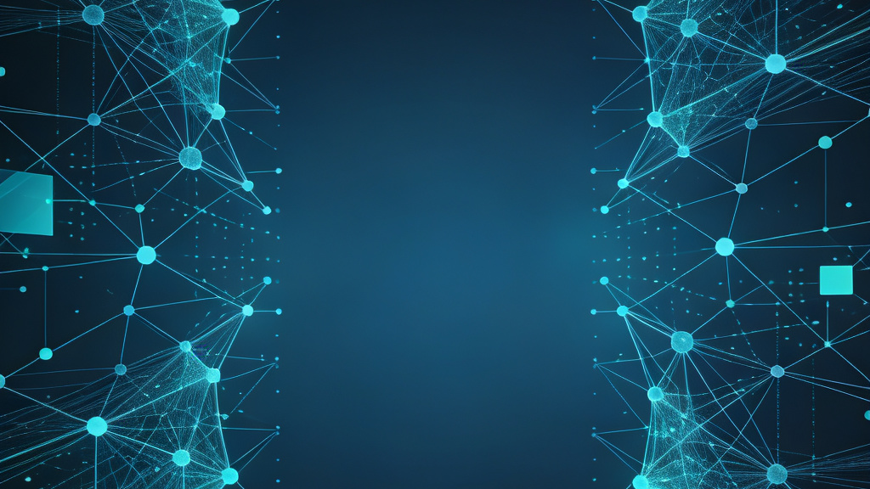
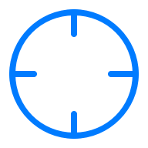



Introduction: Background & Challenges
Research Background
Core Challenges
Retinal vessels are the only non-invasively visualizable deep microvascular network. Their morphological changes are closely associated with diseases like Diabetic Retinopathy (DR) and glaucoma. Automatic and accurate segmentation is key to early screening and diagnosis.
Image Quality Issues
Noise, low contrast, and uneven illumination.
Structural Complexity
Large scale variations and tree-like topology.
Pathological Interference
Lesions (exudates, hemorrhages) obscure vessels.
Model Generalization
Difficulty adapting to diverse real-world scenarios.
Notes:
接下来，我们来深入了解一下研究的背景和面临的挑战。视网膜血管是人体唯一可以无创观察到的深层微血管网络，其形态变化与多种疾病密切相关。因此，实现血管的自动精准分割对于疾病的早期筛查至关重要。然而，这项任务极具挑战性，主要体现在四个方面：图像质量问题、血管结构的复杂性、病理区域的干扰以及模型的泛化能力。

Slide 4
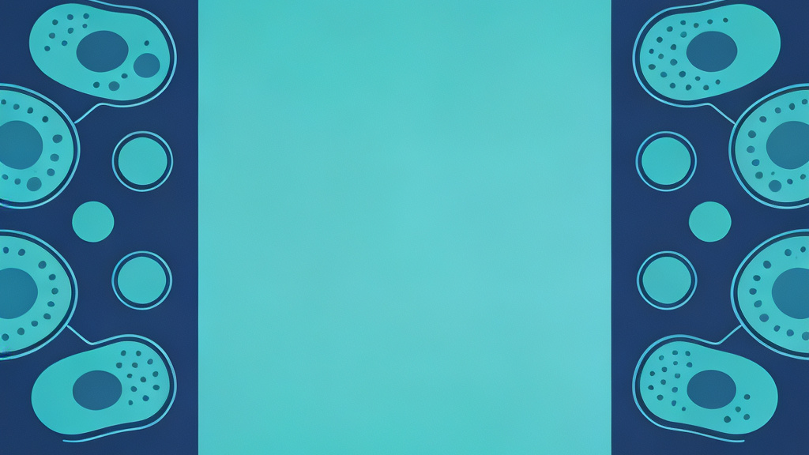
Related Work
Method Category | Core Idea | Strengths & Weaknesses
Traditional Methods | Image processing + mathematical morphology + classical ML | Simple, low cost; Poor accuracy for complex images.
U-Net & Its Variants | Encoder-decoder + skip connections; UNet++ optimizes multi-scale fusion | Stable main vessel segmentation; Fine branch loss due to CNN's local limitation.
Transformer-based Methods | Self-attention mechanism models global pixel dependencies | Excellent topology restoration; High computational complexity.
Notes:
在正式介绍我们的方法之前，让我们先回顾一下相关的研究工作。视网膜血管分割方法大致可以分为三类：传统方法、U-Net及其变体，以及基于Transformer的方法。传统方法原理简单，但精度有限。U-Net系列模型凭借其对称的编解码器结构和跳跃连接，在医学图像分割领域取得了巨大成功，但受限于CNN的局部感受野，在处理细小血管时仍有不足。近年来，基于Transformer的方法因其强大的全局建模能力而备受关注，能够很好地恢复血管的拓扑结构，但计算复杂度较高。

Slide 5
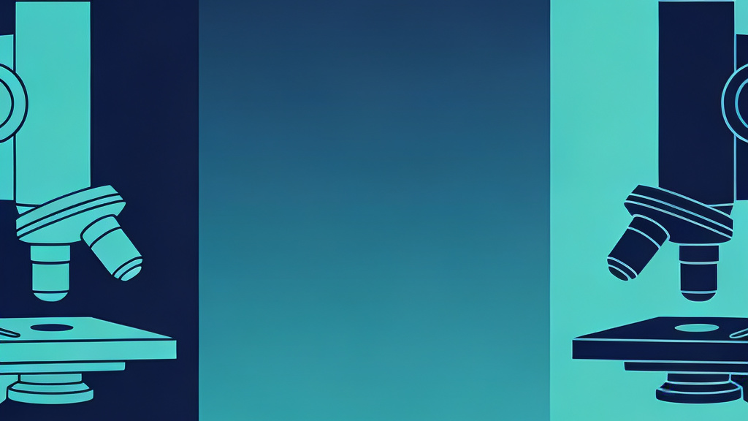

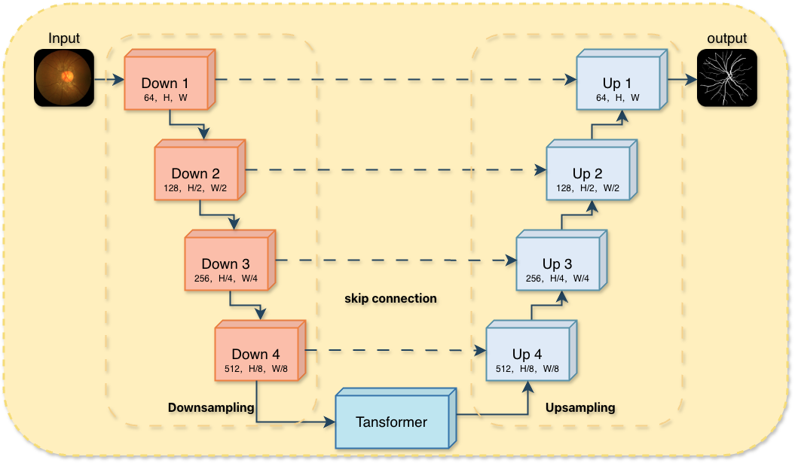
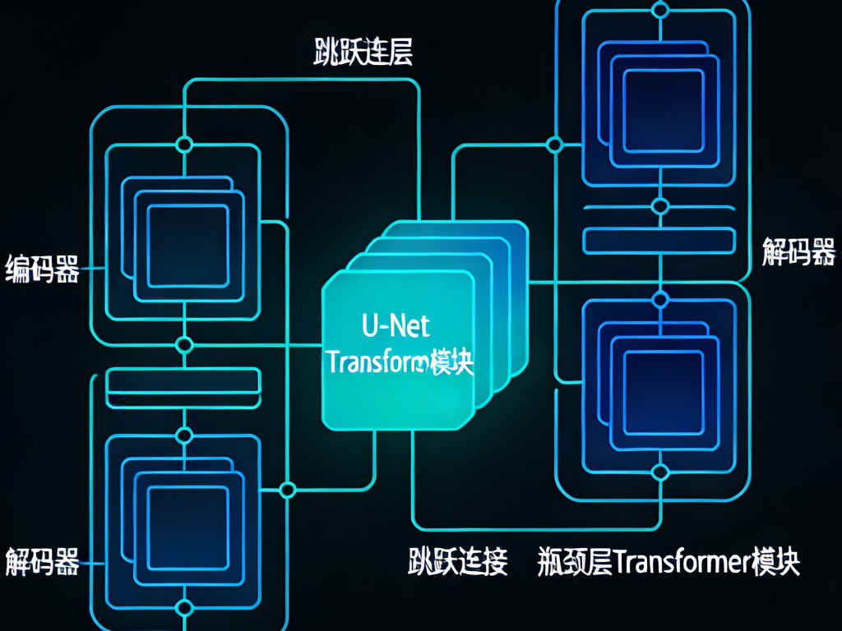


Model Architecture: U-Net + Transformer
Overall Structure
The backbone is U-Net. Our innovation embeds a Transformer at the bottleneck, leveraging U-Net's local details and Transformer's global context.
Key Modules
U-Net:Multi-scale feature extraction via encoder-decoder and skip connections.
Transformer:Models global dependencies to capture vessel topology.
Synergy:Enhances connectivity by combining local and global insights.
Schematic of the proposed U-Net + Transformer architecture
Notes:
为了克服现有方法的局限性，我们提出了一种融合U-Net和Transformer的新模型。如图所示，我们的模型以U-Net作为骨干网络，负责提取多尺度的局部特征。同时，我们在瓶颈层嵌入了一个Transformer模块，利用其自注意力机制来建模全局的像素依赖关系。这种协同优化的设计，旨在结合卷积神经网络的局部特征提取能力和Transformer的全局建模能力，从而更精准地分割视网膜血管。

Slide 6
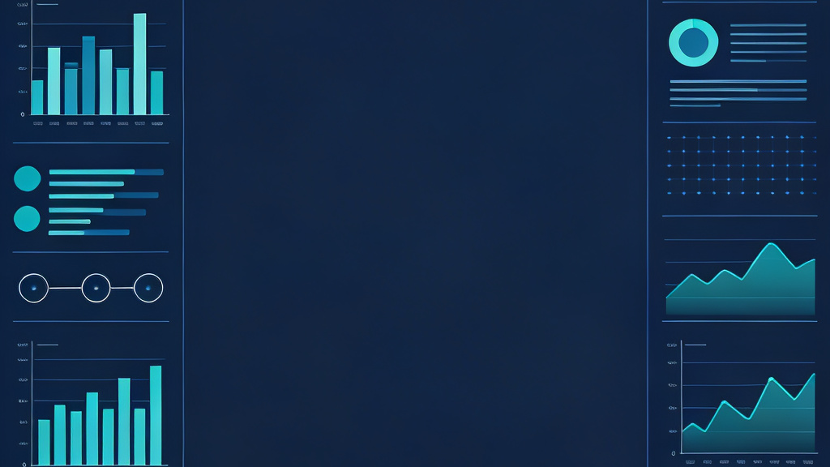







Experimental Setup
Datasets
Evaluation Metrics
Training Config
We used two public benchmarks:
DRIVE:40 fundus images (565×584).
STARE:Supplementary validation set.
Quantitative:Acc, Sen, Spe, AUC.
Qualitative:Visual inspection of continuity, fine branches, and topology.
Framework:PyTorch
Optimizer:Adam (1e-4)
Loss:BCE + Dice Loss
Hardware:RTX 4090 GPU
Our comprehensive experimental setup ensures rigorous validation of the proposed model across multiple dimensions, leveraging standard benchmarks and robust evaluation protocols.
Notes:
为了验证我们模型的有效性，我们设置了一系列对比实验。实验基于两个公开的基准数据集：DRIVE和STARE。我们从定量和定性两个方面进行评估，定量指标包括准确率、灵敏度、特异度和AUC，定性评估则主要关注血管的连续性、细小分支的提取情况以及拓扑结构的正确性。模型的训练基于PyTorch框架，使用Adam优化器和BCE-Dice混合损失函数。

Slide 7
Quantitative Results
Method | Acc | Sen | Spe | AUC
UNet | 0.7623 | 0.7352 | 0.9620 | 0.8988
UNet++ | 0.7870 | 0.7615 | 0.9712 | 0.9189
TransUNet | 0.7952 | 0.8245 | 0.9856 | 0.9821
Key Conclusions
TransUNet outperforms both UNet and UNet++ across all evaluation metrics. Notably, its Sensitivity (Sen) is 8.93% higher than that of UNet, demonstrating superior ability in extracting fine vessel branches.
Notes:
首先来看定量实验的结果。这张表格展示了三个模型在DRIVE数据集上的性能对比。可以清楚地看到，我们提出的TransUNet模型在所有指标上都取得了最好的结果。特别是在衡量细小血管提取能力的灵敏度（Sen）指标上，TransUNet达到了0.8245，比传统的UNet高出了近9个百分点，这充分证明了其在捕捉血管细节方面的优越性。

Slide 8
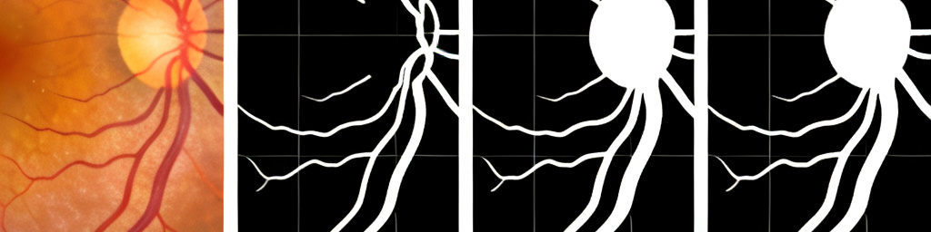


Qualitative Results: Overview
Original
UNet
UNet++
TransUNet
The input fundus image.
Accurate main vessels but obvious loss of fine branches.
Improved fine branch extraction but still incomplete.
Most complete segmentation with superior topological connectivity.
Notes:
接下来，我们通过定性结果来更直观地感受三个模型的分割效果。这张图展示了一个典型的分割案例。从左到右分别是原始图像、UNet、UNet++和我们的TransUNet的分割结果。大家可以看到，UNet能够很好地分割出主要的血管，但在细小分支上丢失严重。UNet++有所改善，但仍然不够完整。而我们的TransUNet模型，能够分割出最完整的血管网络，包括大量的细小分支，并且血管的连续性和拓扑结构都得到了最好的保持。

Slide 9
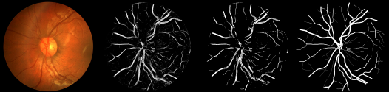
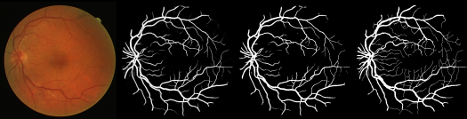
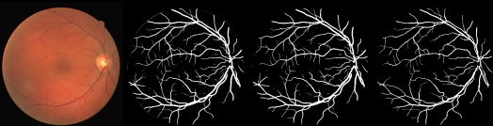
Qualitative Results: Complex Scenarios
Scenario : Original fundus image and the segmentation results of the three models
Notes:
为了进一步验证模型在复杂场景下的性能，我们还测试了两个极具挑战性的区域。左栏展示的是血管高度密集且交织在一起的区域。可以看到，在这种情况下，TransUNet依然能够保持最准确的拓扑结构。右栏展示的是视网膜的边缘区域，这里的血管非常细小和微弱。结果表明，TransUNet在提取这些边缘细小血管方面也具有明显的优势。

Slide 10


Discussion: Comparison & Limitations
Evaluation Dimension | UNet | UNet++ | TransUNet
Main Vessel Continuity | Stable but stiff | Natural transitions | Optimal
Fine Branch Extraction | 15-20% loss | ~80% retention | >90% retention
Topological Restoration | Prone to confusion | Slight distortion | Precise matching
Limitations
Future Directions
Dataset Limitations:Lack of validation on diverse clinical images.
Expand dataset with more clinical cases.
Computational Efficiency:Transformer module increases complexity.
Explore model lightweighting for real-time use.
Few-shot Adaptability:Performance needs improvement with limited data.
Investigate semi/self-supervised learning.
Notes:
在讨论部分，我们对三个模型的核心性能进行了总结。从表格中可以看出，TransUNet在主血管连续性、细小分支提取和拓扑结构恢复三个维度上都表现最佳。当然，我们的研究也存在一些局限性，例如数据集的多样性不足，模型的计算复杂度较高等。未来，我们计划从扩展数据集、模型轻量化和探索新的学习范式等方面进行深入研究。

Slide 11




Conclusions
Performance Ranking
Based on comprehensive evaluation, the performance of the three models is ranked as:TransUNet > UNet++ > UNet.
Model Positioning
TransUNet:Ideal for high-precision clinical screening with fine branch extraction.
UNet++:Balances efficiency and accuracy, suitable for engineering deployment.
UNet:Stable for main vessel segmentation, for low-precision scenarios.
Key Finding
Transformer's global attention mechanism is crucial for overcoming CNN limitations in retinal vessel segmentation.
Research Value
This study provides valuable technical support for automated DR diagnosis systems.
Notes:
最后，让我们对本次研究做一个总结。第一，综合来看，三个模型的性能排序为TransUNet优于UNet++，而UNet++又优于传统的UNet。第二，不同的模型有其各自的适用场景，TransUNet适合高精度筛查，UNet++兼顾效率与精度，而UNet则适用于一些对精度要求不高的场景。第三，我们的关键发现是，Transformer的全局注意力机制是突破CNN在视网膜血管分割任务中局限性的关键。第四，本研究建立的多维度评估体系，为后续的研究和临床应用提供了有价值的技术支持。

Slide 12


References & Acknowledgements
References
Ronneberger, O., Fischer, P., & Brox, T. (2015). U-net: Convolutional networks for biomedical image segmentation. InInternational Conference on Medical Image Computing and Computer-Assisted Intervention(pp. 234-241). Springer, Cham.
Zhou, Z., Siddiquee, M. M., Tajbakhsh, N., & Liang, J. (2018). Unet++: A nested u-net architecture for medical image segmentation. InDeep Learning in Medical Image Analysis(pp. 3-11). Springer, Cham.
Chen, J., et al. (2021). Transunet: Transformers make strong encoders for medical image segmentation.IEEE Transactions on Medical Imaging, 41(3), 682-693.
Acknowledgements
We would like to thank the members of our laboratory for their valuable discussions and feedback. We also acknowledge the providers of the DRIVE and STARE datasets for making their data publicly available.
Notes:
最后，再次感谢大家的聆听。我们的研究工作离不开前人的贡献，这里列出了我们主要参考的几篇文献。同时，也要感谢实验室的各位同仁以及数据集的提供者。谢谢大家！

